Slide 1
Malignant Comments Classification
Submitted by
Tushar Kumar Patel

Slide 2
Project analysis slide 2
Project Analysis
Inrtoduction
Visualization
Malignant Comments Classification
Dataset and Features
Model
Processing
Conclusion

Slide 3
Introduction
The proliferation of social media enables people to express their opinions widely online. However, at the same time, this has resulted in the emergence of conflict and hate, making online environments uninviting for users. Although researchers have found that hate is a problem across multiple platforms, there is a lack of models for online hate detection.
Online hate, described as abusive language, aggression, cyberbullying, hatefulness and many others has been identified as a major threat on online social media platforms. Social media platforms are the most prominent grounds for such toxic behaviour.
There has been a remarkable increase in the cases of cyberbullying and trolls on various social media platforms. Many celebrities and influences are facing backlashes from people and have to come across hateful and offensive comments. This can take a toll on anyone and affect them mentally leading to depression, mental illness, self-hatred and suicidal thoughts.
Internet comments are bastions of hatred and vitriol. While online anonymity has provided a new outlet for aggression and hate speech, machine learning can be used to fight it. The problem we sought to solve was the tagging of internet comments that are aggressive towards other users. This means that insults to third parties such as celebrities will be tagged as unoffensive, but “u are an idiot” is clearly offensive.
Our goal is to build a prototype of online hate and abuse comment classifier which can used to classify hate and offensive comments so that it can be controlled and restricted from spreading hatred and cyberbullying.

Slide 4
CONCEPTUAL BACKGROUND OF THE DOMAIN PROBLEM
In the past few years its seen that the cases related to social media hatred have increased exponentially. The social media is turning into a dark venomous pit for people now a days. Online hate is the result of difference in opinion, race, religion, occupation, nationality etc.
In social media the people spreading or involved in such kind of activities uses filthy languages, aggression, images etc. to offend and gravely hurt the person on the other side. This is one of the major concerns now.
The result of such activities can be dangerous. It gives mental trauma to the victims making their lives miserable. People who are not well aware of mental health online hate or cyber bullying become life threatening for them. Such cases are also at rise. It is also taking its toll on religions. Each and every day we can see an incident of fighting between people of different communities or religions due to offensive social media posts.
Online hate, described as abusive language, aggression, cyberbullying, hatefulness, insults, personal attacks, provocation, racism, sexism, threats, or toxicity has been identified as a major threat on online social media platforms. These kinds of activities must be checked for a better future.

Slide 5
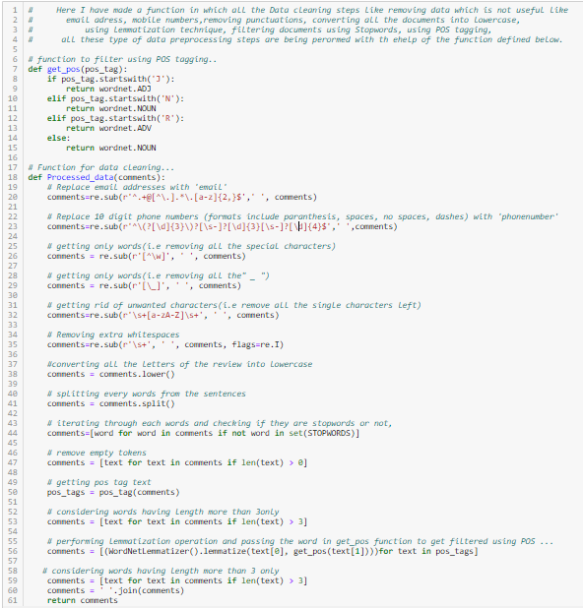
DATA PRE-PROCESSING
For Data pre-processing we did some data cleaning, where we used wordNet lemmatizer and porterStemmer to clean the words and removed special characters using Regexp Tokenizer and filter the words by removing stop words and then used lemmatizers and joined and return the filtered words.
Used TFIDF vectorizer to convert those text into vectors, and split the data and into test and train and trained various Machine learning algorithms.

Slide 6
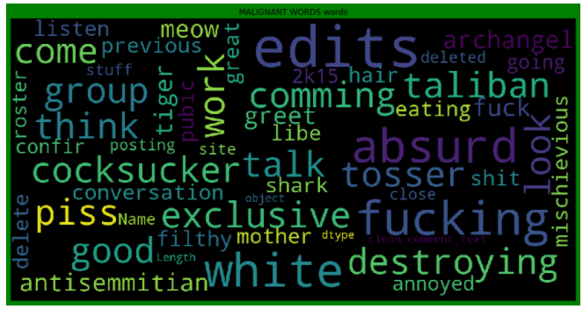
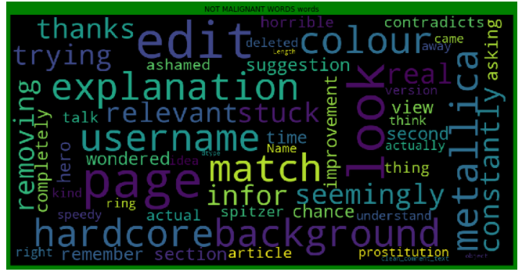
DATA INPUT- LOGIC-OUTPUT RELATIONSHIPS
Malignant WORDS
NOT Malignant WORDS
From the above we can see that most frequent words for both Malignant and Non Malignant category.

Slide 7
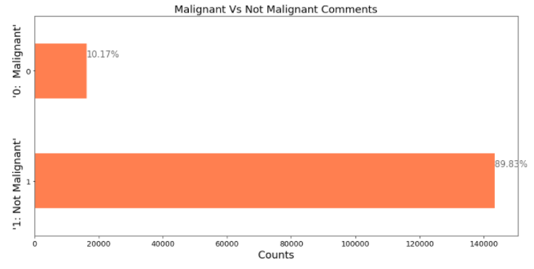
MODEL/S DEVELOPMENT AND EVALUATION

Slide 8
MODEL/S DEVELOPMENT AND EVALUATION
Testing of Identified Approaches (Algorithms)
LR=LogisticRegression()
MNB=MultinomialNB()
PAC=PassiveAggressiveClassifier()
DT=DecisionTreeClassifier()

Slide 9
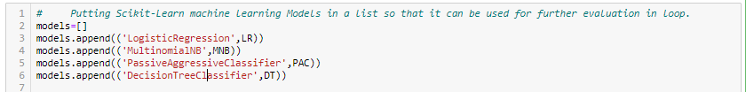
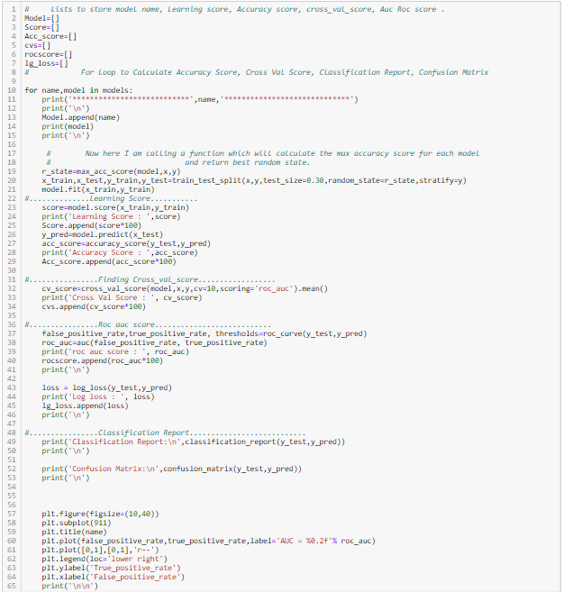
MODEL/S DEVELOPMENT AND EVALUATION
Run and Evaluated Some Selected models

Slide 10
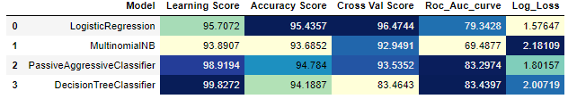
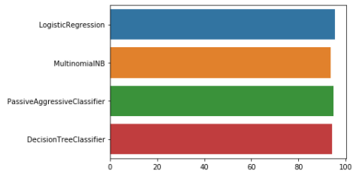
Key Metrics for success in solving problem under consideration
After all this process conclusion is that Passive Aggressive Classifier is giving accuracy of 94.78%. So, now I am making a final model using Passive Aggressive Classifier.

Slide 11
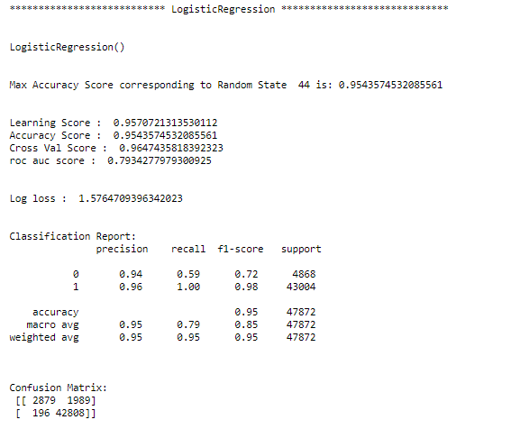
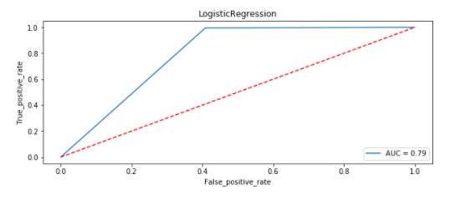
MODEL/S DEVELOPMENT AND EVALUATION
Logistic Regression Visualization:

Slide 12
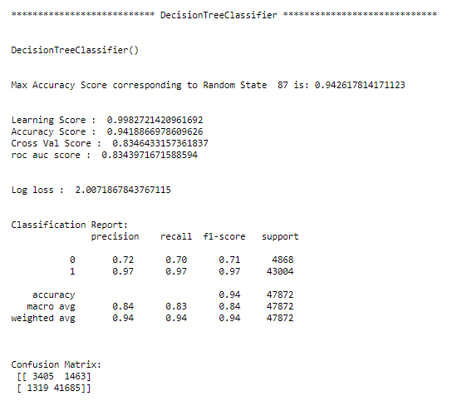
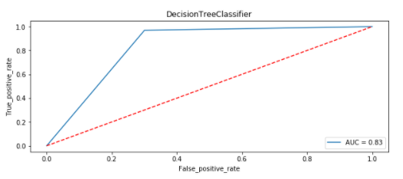
MODEL/S DEVELOPMENT AND EVALUATION
Decision Tree Classifier Visualization:

Slide 13
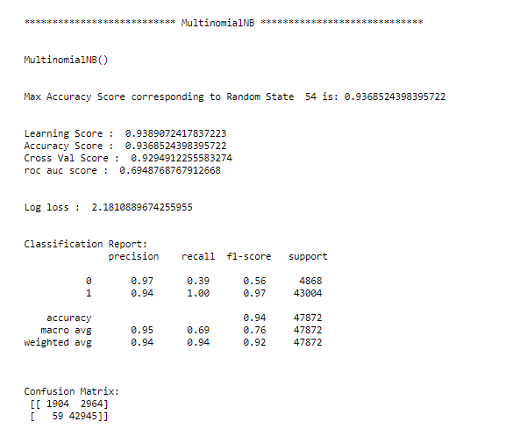
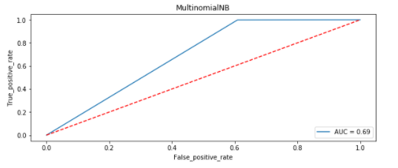
MODEL/S DEVELOPMENT AND EVALUATION
MultiNomial NB Visualization:

Slide 14
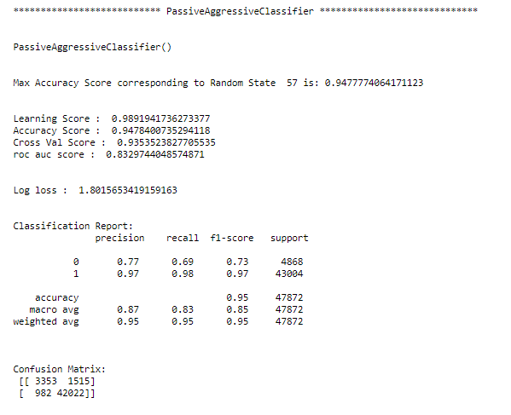
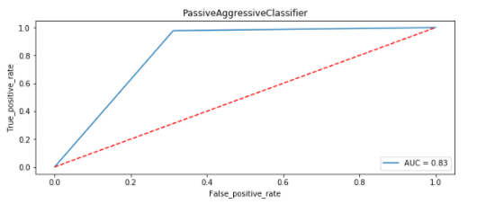
MODEL/S DEVELOPMENT AND EVALUATION
Passive Aggressive Classifier Visualization:

Slide 15
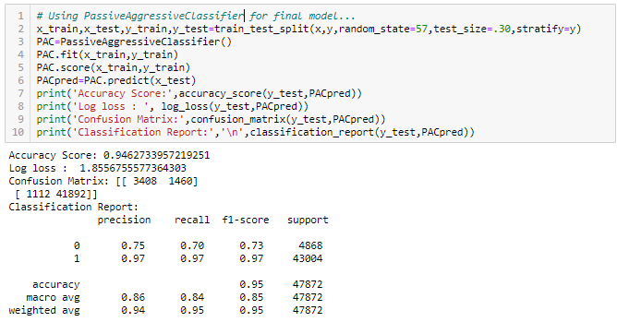
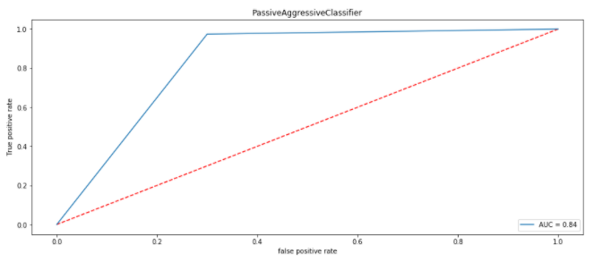
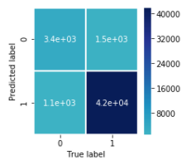
Final model
From the above visualization and matrices found that the Passive Aggressive Classifier performed the best AUC_ROC_SCORE i.e. 94.78%.

Slide 16
Interpretation of the Results
From the above visualization and matrices found that the Passive Aggressive Classifier performed the best AUC_ROC_SCORE i.e. 94.78%.

Slide 17
CONCLUSIONS
Online hate, described as abusive language, aggression, cyberbullying, hatefulness and many others has been identified as a major threat on online social media platforms. Social media platforms are the most prominent grounds for such toxic behaviour.
From the above analysis the below mentioned results were achieved which depicts the chances and conditions of a comment being a hateful comment or a normal comment.
With the increasing popularity of social media, more and more people consume feeds from social media and due differences they spread hate comments to instead of love and harmony. It has strong negative impacts on individual users and broader society.

Slide 18
Thank You

